Slide 1
DevOps Strategy for PriaccEnterpriseAI
Responsibilities
As a DevOps Engineer, our responsibilities included:
Containerizing the system using Docker
Multi-service orchestration with Docker Compose
CI/CD automation using GitHub Actions
Cloud/local deployment
Environment variable management & service linking
Documentation of deployment steps

Slide 2
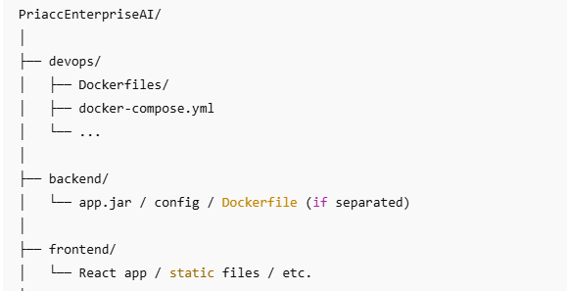
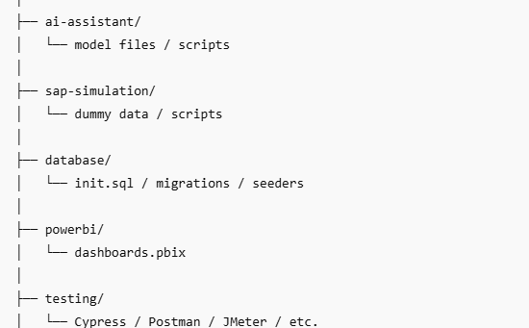

Slide 3
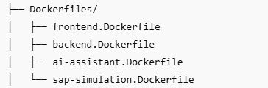
Multi-Service Docker Architecture
All services have individual Dockerfiles
Located in devops/Dockerfiles/
Modular and independently deployable components

Slide 4
Dockerfile Strategy
Frontend.Dockerfile: React or frontend framework image
backend.Dockerfile: Node/Express backend
ai-assistant.Dockerfile: Likely NLP or chatbot service
sap-simulation.Dockerfile: Simulated SAP system for integration testing
Lightweight, production-ready images

Slide 5
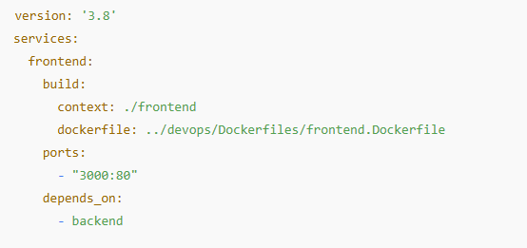
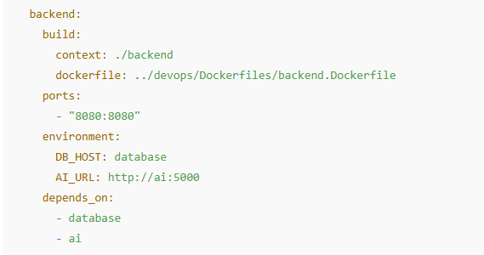
Local Orchestration with Docker Compose
Manages all services from a single file
Simplifies testing and local development
Networks all services internally

Slide 6
Automated CI/CD Pipeline
Configured via .github.workflows/deploy.yml
Triggers on push/pull_request
Builds Docker images and optionally pushes to registry
Can deploy to staging/production environments

Slide 7
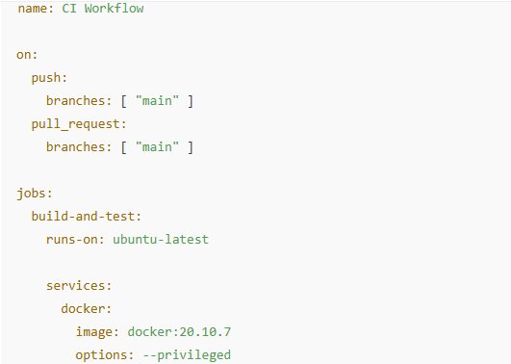
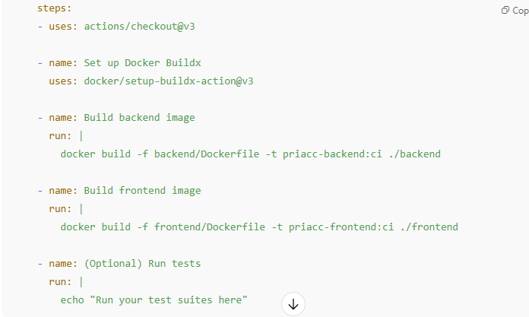
Sample GitHub Actions Workflow

Slide 8
Development and Testing Workflow
Local development with Docker Compose
Automated builds on commit
Staging environment mimic production
Logs and monitoring integrated with Amazon Cloudwatch.

Slide 9
Summary & Road Ahead
Key Takeaways
Modular, containerized architecture using Docker
Unified orchestration via Docker Compose
Automated CI/CD with GitHub Actions
Scalable and testable development workflow
Strong foundation for cloud deployment and microservices
🚀 Next Steps / Future Enhancements
Integrate AWS/GCP/Azure deployment pipelines
Implement container orchestration with Kubernetes
Add monitoring/logging stack (e.g., ELK, Prometheus + Grafana)
Add automated testing (unit + integration) in CI
Use Helm charts for deployment templating

